Slide 1
Automata and Theory of Computation
Turing Machine
Notes:
Farazul H Bhuiyan
Lecturer
Dept. of CSE
BRAC University
Bangladesh

Slide 2


Slide 3
Turing Machine: Getting Started
Was invented by Alan Turing in 1936
Consists of an infinite length tape, on which
input is provided as a finite sequence of symbols.
contains input symbol or A special symbol called blank.
Performs Read and/or Write operations
Consists of a head pointer
points to cell currently being read
Can move in both directions.

Slide 4
Turing Machine: Formal Definition
Expressed as a 7-tuple (Q, T, ∑, B, q₀, F, δ,)
Q - a finite set of states
T - the tape alphabet (symbols that TM writes)
∑ - the input alphabet (symbols that TM reads)
B - blank symbol (every cell is filled with B except input alphabet initially)
q₀ - the initial state
F - the set of final states and if reached, input string is accepted

Slide 5
Turing Machine: Formal Definition
δ - a transition function
Based on the present state and present tape alphabet,
What would be the next state,
Would change the tape symbol or not
Would move the head pointer to left or right.

Slide 6
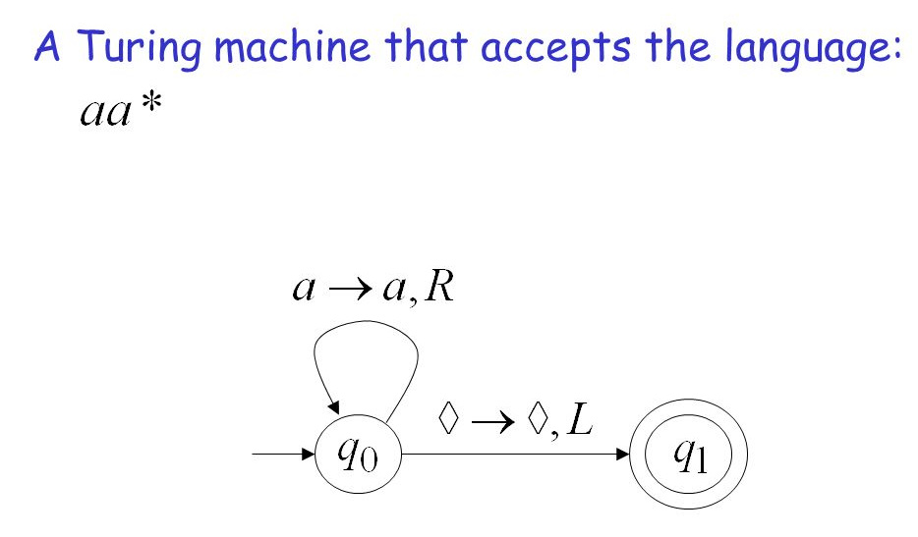
Turing Machine: Example (Simplest)

Slide 7
Turing Machine: Example
{w | w is in {0,1}* and w ends with a 0}

Slide 8
Turing Machine: Example
Counter: TM that reads the current binary number printed on the tape and increments it by 1 before stopping.

Slide 9
Turing Machine: Example
Counter: TM that reads the current binary number printed on the tape and increments it by 1 before stopping.
State\Input | B | 0 | 1
X | (Y, B, R) | (X, 0, L) | (X, 1, L)
Y | (Z, 1, L) | (Z, 1, R) | (Y, 0, R)
Z | (Halt, B, R) | (Z, 0, L) | (Z, 1, L)

